Slide 1

Lunch & Learn Play: The Super-Awesome Game
An XNA 4.0 Game by Peter Hoang

Slide 2
Welcome
Purpose:
I wanted to learn how to use the XNA framework
I like writing games
Learning:
What is the XNA 4.0 framework?
Common game engine design
Game’s source code examples
Playing:
About the game
How to play
Controls

Slide 3
Part 1: The Boring Learning Part
What is XNA?
Game Engine Architecture
My source code

Slide 4
XNA 4.0 Framework
Cross-platform
Windows Phone
Xbox 360 console
Windows PC
Based on the .NET Framework 4
C#
Visual Studio 2010 (intellisense)
Widely used
Lots of documentation and resources

Slide 5
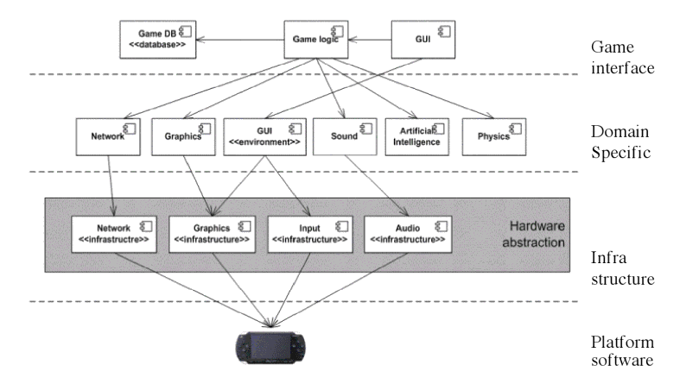
Game Engine Architecture

Slide 6
Game Loop
Constructor() and/or Initialize()
Load the game’s assets such as graphics and sounds
Update(t)
Game logic
Handle user input
Physics
Draw()
Draws the game graphics on screen

Slide 7
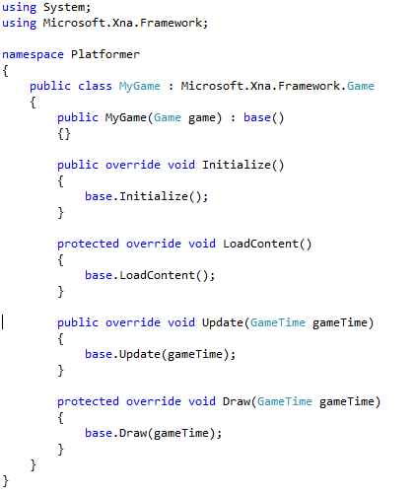
XNA’s “Game Loop”

Slide 8
Traditional/Old Skool Way
Component-based
Functional-reactive programming
Entity
Player
Enemy
Blocks
Weapons
Koomba
Bowser
Power Up
Draw(t)
Update(t)
LoadContent()

Slide 9
Popular Game Engines
FlatRedBall
XNA-based
Cocos2D
Unity
Game Maker
Unreal Engine
AAA

Slide 10
Source Code @ github
https://peterhoang@github.com/peterhoang/Super-Duper-Game.git

Slide 11
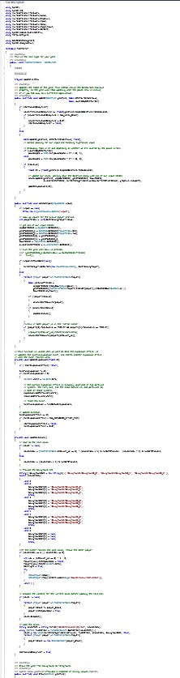
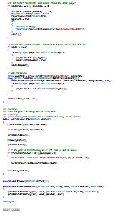
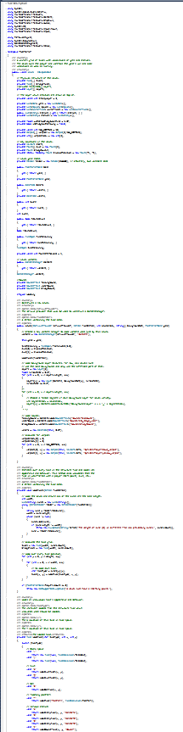
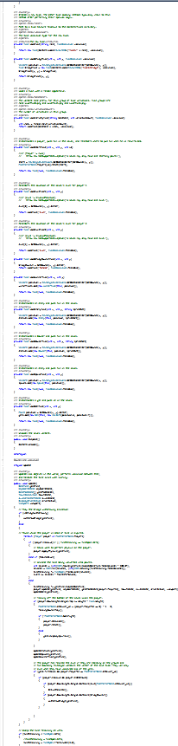
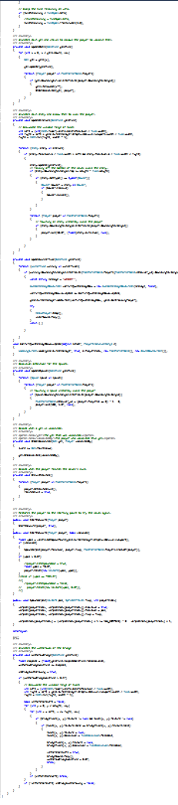
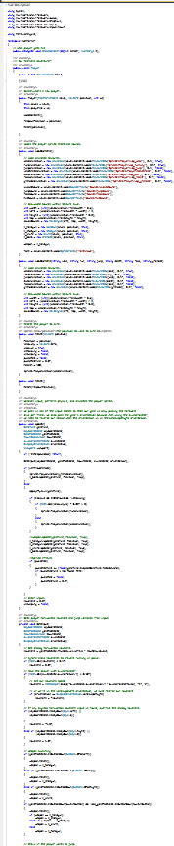
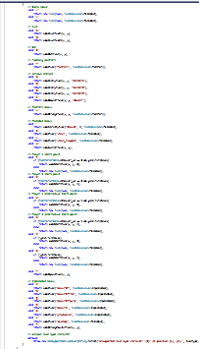
Source Code Sample

Slide 12
Act II: The Fun Part
About the game
How to play
Controls

Slide 13
About the Game
Inspired by a game called Nidhogg, an indie sword fighting game
I wanted to create a simple and fun game while learning the XNA 4.0 Framework
So I can work on Windows Phone or equivalent projects
Hint Hint
Created for theHackathon Vlad started but I scope-creeped myself.

Slide 14




Rules (are meant to be broken)
It’s a two-player game. One player is blue the other is yellow.
There’s always only one attacker and one defender. The roles swap depending on the outcome of a fight.
The goal is to reach the last level. A colored arrow will point you the way.

Slide 15



Rules (cont’d)
As an attacker, you must go in the direction of your colored arrow while fighting the defender. You become a defender if you are defeated.
As a defender, you must defeat the attacker and prevent him from reaching the end of the level. You become the attacker if you defeat your opponent.
The game ends when the attacker reaches the last level.

Slide 16

The player who reaches the last level wins

Slide 17

…and the other player…

Slide 18
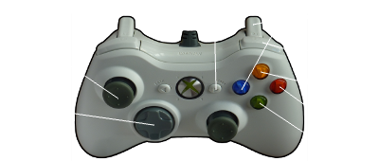
Controls

Slide 19





Moving & Jumping
The left Joystick controls the movement of the player
Press button A to jump.
Hint: you move slower while in the air
Hint: you jump slightly further by doing a “running” jump

Slide 20


Rolling
Press the B button to execute a roll.
You can only roll every ~1.5 seconds.
Hint: you can avoid most things by rolling. E.g. deadly attacks.

Slide 21
Handgun
Longest range
Highest rate of attack
Lowest damage
Left on the DPad

Slide 22



Shotgun
Heavy damage
Medium rate of fire
Low - medium range
Up on the DPad

Slide 23

Knife
Very high damage
Very low range
You can only use it every ~3 seconds
Right on the Dpad

Slide 24
Bomb
Very high damage
Variable range
Use the Right Shoulder button
The longer you hold it, the further you can toss the bomb

Slide 25
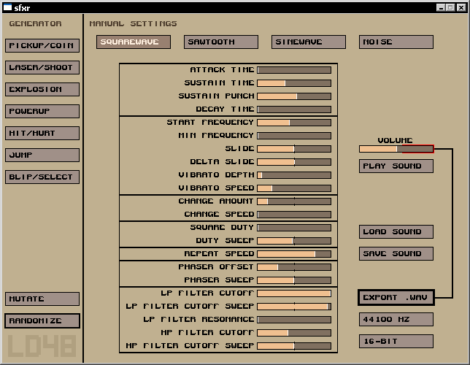
SFXR
I used this nifty little tool to help me create some of the sound effects used in the game
http://www.drpetter.se/project_sfxr.html

Slide 26
Further Comments
I shamelessly ripped graphics, sounds and music so I probably won’t be able to publish this game until I spend some time to create the custom assets.
I’m closing this project. I’ll make game balances if the game is played. I might change or add more levels. But that’s pretty much the extent.
If there is a phase 2, I would be working on custom graphics and such so I can publish it on Xbox Live.

Slide 27
Contact
Please send your suggestions, feedback, and bugs to:
no-reply@digiflare.com

Slide 28
Special Thanks
Digiflare. Obvious.
All the random people on the Internet writing informative documents for me to learn from.
Everybody here.
God

Slide 29
QA
Unfortunately, cancelled in favor of play time!

